Slide 2
Front-end Web Infrastructure for Netscout VMSportal
Kaitlyn Lineberry Mathematics, database & analytical research
Justin Lukas Computer Science, project lead
Elliot Miller Computer Science, technical principle
Morgan Patrick Chemical Engineering, communication lead & solution analysis
Erika Pope Computer Science, technical principle & secretary
April 23, 2018

Slide 3
Agenda
Project Overview
Business application
Semester goals
Semester 2 Recap
Deliverables
Challenges
Lessons learned
Demonstration of Product
Analysis of Database Placement
Solution in-house vs. in cloud
Cost comparison
Cloud environments

Slide 4
Project Overview

Slide 5
Business Application
Current
Ideal
Currently limited scalability
Difficulty of expansion
beyond the first 100 sites
more than 2 service providers
Difficulty managing data access permissions for users
Costly server environment
Limited functionality of Spreadsheets
(only able to pull data using one unique key)
Possibility of stale (outdated) data
Web portal front end for VMS Database will enable scalability
Accommodate any range of sites and service providers
Operates dynamically preventing stale data
User-friendly homepage with snapshot information
Housed in accessible, efficient environment
Increase employee & economic efficiency
Low downtime

Slide 6
Semester Goals
Sprints
Weekly goals
Business application
Technical & design
Modularity, applets, tab linkage, data understanding
Login options, populated & dynamic homepage
Business benefit charts on homepage
Data pull for charts on homepage
Final presentation, loose end cleanup

Slide 7
Semester 2 Recap

Slide 8
Deliverables
Product
Front-end developed website
Flexible homepage
Dynamic with changing data
Charts & snapshots
Analysis
Analysis of database location
Location & cost comparison
Alternative solutions

Slide 9
Challenges & Lessons Learned
Challenges
Lessons Learned
Experience with telecommunication and professional communication
Developed stronger grip on business applications from real solutions
Practice with project management
Experience with new software languages and design
Analytical skills in research and cost comparisons
Scheduling
Cross-team communication
New languages & environments
Unfamiliarity with project actions

Slide 10
Product Demonstration

Slide 11
Netscout VMSportal
*Link*

Slide 12
Solution Deployment Business Analysis
Spring 2018

Slide 13
OUTLINE
Problem Identification
Proposal Introduction
Conceptual Analysis
Cost Analysis
Alternatives
Summary

Slide 14
PROBLEM & PROPOSAL
Project:
Problem:
Where to deploy the VMS solution
Location Factors:
Availability/Geographic Redundancy
Scalability
Downtime
Security
Economic Impact
Connectivity
Analyze business benefits of solution in two proposed locations
1. In-House
2. Cloud
Project 25% YOY on both
7-year analysis

Slide 15
PROPOSAL #1: Solution In-House

Slide 16
In-House Dis/Advantages
Accessibility
Single points of failure
Netscout internet connectivity
Plano/Allen VPN
Scalability
Additional purchases/installments
Additional Necessities
Specialized IT Team
Physical space for servers
Cost
Initial investment
Hardware service
Hardware replacement
Expensive expansion
Disks, servers, licenses
Opportunity Cost
Loss of employee productivity
Cheaper storage expansion
Performance
Relocation
Downtime before, during, and after move
Data movement = data loss risk
Control
Secured behind VPN and firewall
Physical access to server
Easy access for repairs
Total control over server processes

Slide 17
PROPOSAL #2: Solution in Cloud

Slide 18
Cloud Dis/Advantages
Performance
No control over server crash/repair
Enterprise responsible for security configuration
Constant use of product
No downtime when relocating
Constant data saving, minimize data loss
Cloud historically and predictably successful
Accessibility
Accessible in all locations
No VPN required
Data resiliency -Free movement to another server in case of failure
BYODevice policy possibilities
Scalability
Pay for additional storage when needed
Solutions are on-demand, pay only for wanted services
Add more in smaller increments
Cost
Cloud spending increasing 4.5% faster than IT spending
25% YOY expensive long-term
Unexpected costs
Performance/security setbacks
No capital expenses
More uptime/use of product
‘Pay for what you use”
Data monetization
Notes:
Availability – access from anywhere,
if lose site, can still get data from other sites – wont lose data

Slide 19
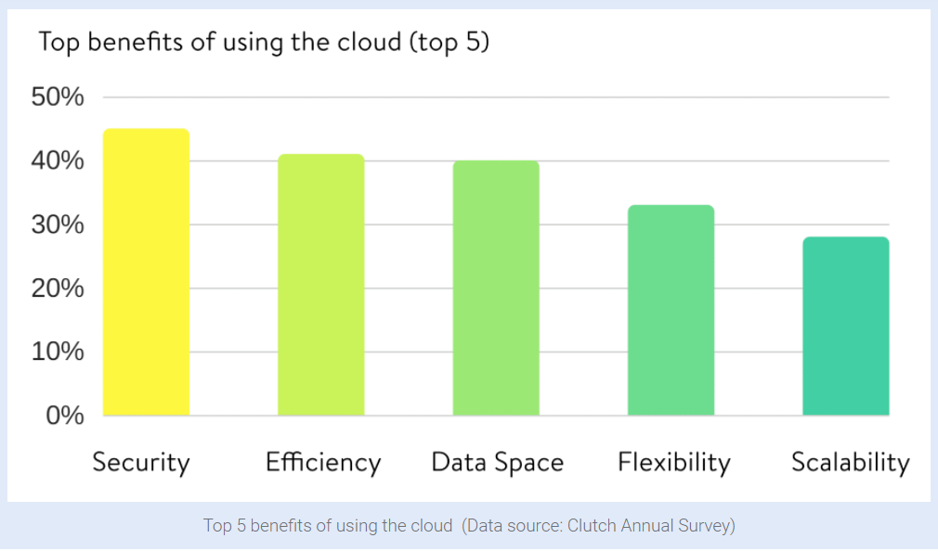
Cloud Advantages
Notes:
Data space ( vs scalability (storage capacity and server capacity)
https://kinsta.com/blog/google-cloud-vs-aws/

Slide 20
Analysis Summary
Solution in-House
Solution in Cloud
Fast
Secure
Controllable
Complex cost structure
Cheaper/more complex expansions
Accessible
Scalable
Movable
Simple cost structure
Timely expansions
Consistent/Reliable
Supported
Productive
Notes:
Looking for cost benefits, go here
For accessibility, go here,
For customer variety (industry and geographically), go here
For …, go ….

Slide 21
Cost Analysis: In-House v. In Cloud

Slide 22
7-Year Comparison
 | Databse in House | Database in Cloud
Year 0 | $ 44,250.00 | $ -
Year 1 | $ 5,000.00 | $ 12,000.00
Year 2 | $15,500.00 | $ 15,000.00
Year 3 | $ 8,000.00 | $ 18,750.00
Year 4 | $ 15,425.00 | $ 23,437.50
Year 5 | $ 45,612.50 | $ 29,296.88
Year 6 | $ 19,261.25 | $ 36,621.09
Year 7 | $ 14,761.25 | $ 45,776.37
7 Year Total | $ 167,810.00 | $ 180,881.84
Notes:
Dependent on electricity cost

Slide 23
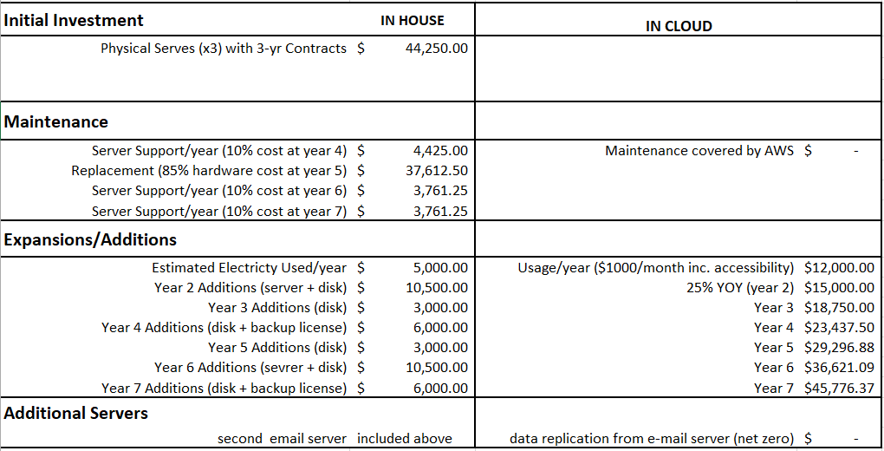
Cost Comparison

Slide 24

Cost Summary
Cost Effective Choice
Solution in House
Notable Differences
Initial Investment
Maintenance
Expansions
year trial

Slide 25
Cloud Environments

Slide 26
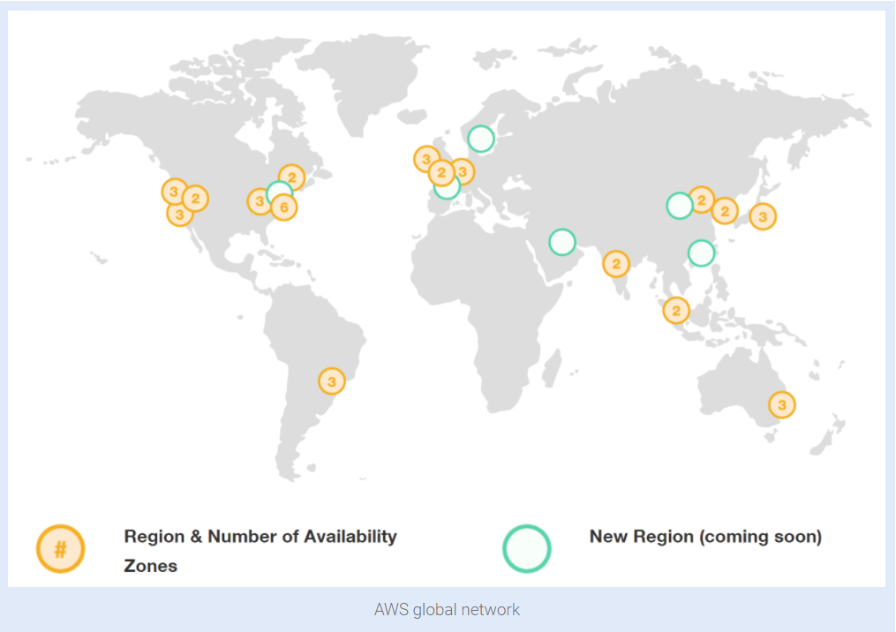
Cloud Environments - AWS
Amazon Web Services
Customers: NASA, Expedia, Central Intelligence Agency (CIA), Netflix, Intuit, Hertz, Time Inc., Unilever, GE, Kellogg’s, G4S
Pros: price reductions, flexibility, accessibility, openness, past performance confidence, ranked 1st in PaaS clouds, per second billing, discounts, GDPR services (access controls, monitoring, logging, encryption)
Cons: quick/unsteady market growth
Notes:
https://aws.amazon.com/compliance/eu-data-protection/ - GDPR help page on amazon
https://kinsta.com/blog/google-cloud-vs-aws/
Platform as a service
General Data Protection Regulation

Slide 27
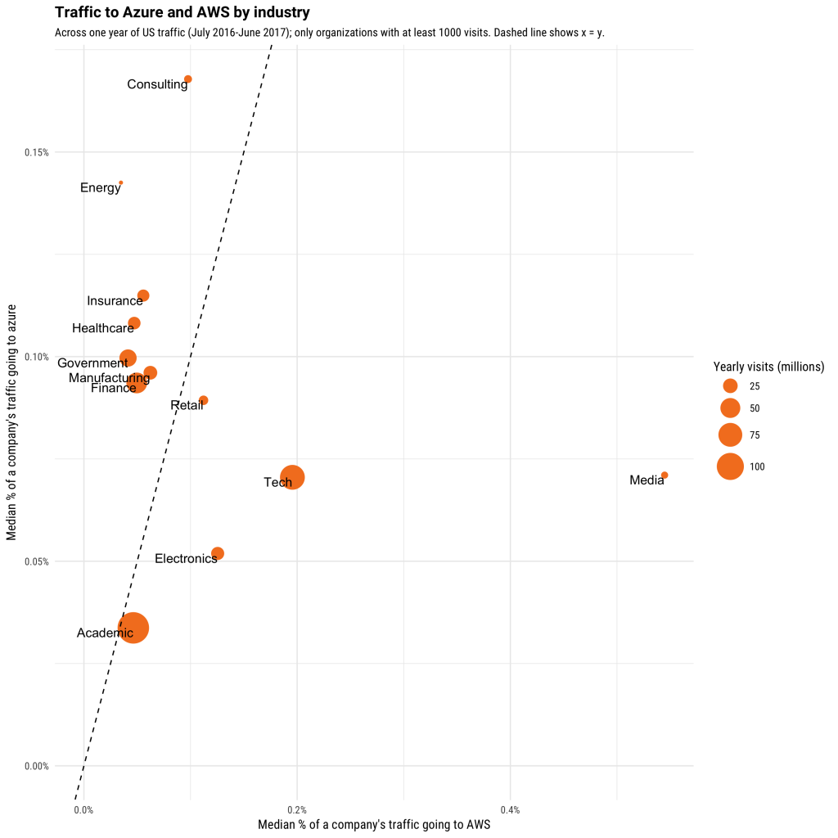
Alternative Cloud Environments - Azure
Microsoft Azure Stack
Customers: Pearson, Ford, NBC News, Easyjet,
Pros: easy transition if already running with Microsoff/Windows, PaaS strength over AWS, currently complies with GDPR
Cons: outages in past, issue with “technical support, documentation, training, and breadth of the ISV partner ecosystem”, difficult to work with anything but Windows Servers
Notes:
Segmentation by industry!
https://www.microsoft.com/en-us/TrustCenter/Privacy/gdpr/default.aspx - GDPR info on website
https://stackoverflow.blog/2017/07/21/trends-cloud-computing-uses-aws-uses-azure/
Independent software vendor

Slide 28
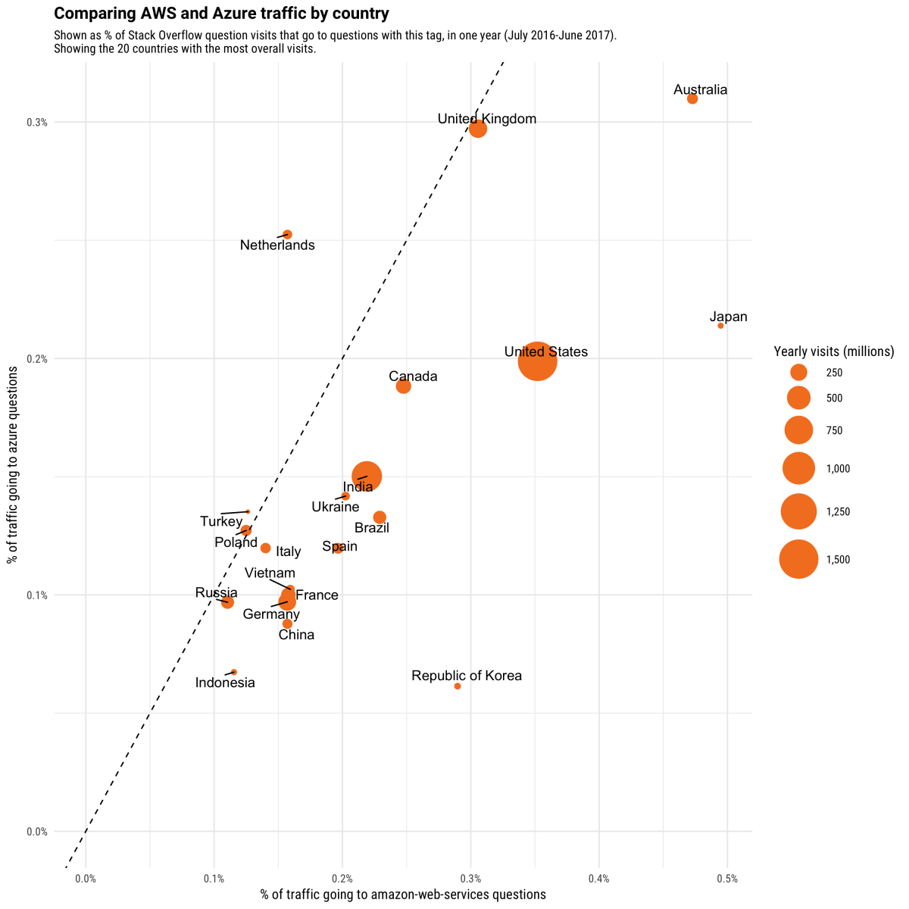
Alternative Cloud Environment- Azure
Notes:
https://stackoverflow.blog/2017/07/21/trends-cloud-computing-uses-aws-uses-azure/

Slide 29
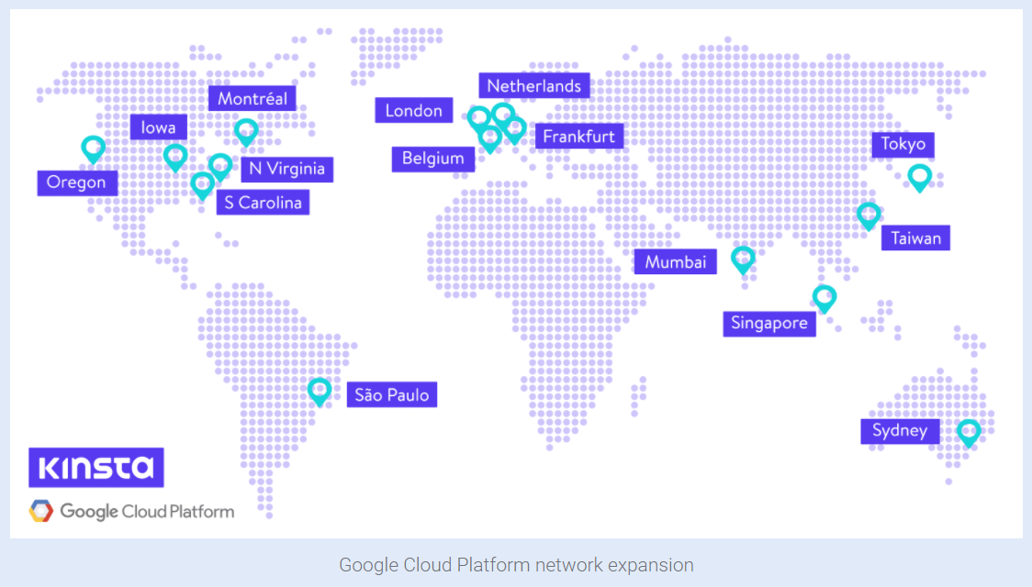
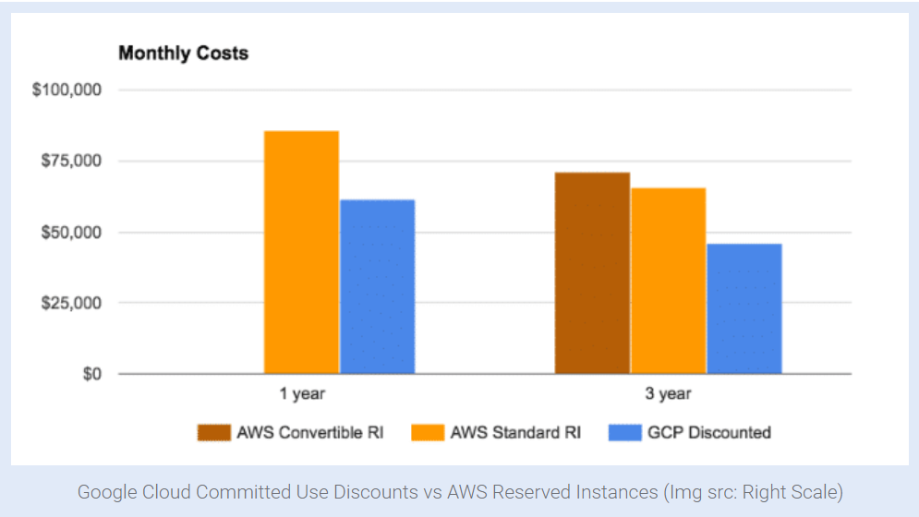
Alternative Cloud Environments - Google
Google Cloud
Customers: UK Bank HSBC, Snapchat, Home Depot, Disney, Coca-Cola, HTC, Sony Music,
Pros: better for innovative cloud-native companies and open source communities, better for smaller projects in large companies, machine learning tools, smallest footprint, handbook on GDPR compliance
Cons: struggles in enterprise market, not often a strategic cloud partner
Notes:
Using in Europe, already have GDPR and updated privacy
https://services.google.com/fh/files/misc/google_cloud_and_the_gdpr_english.pdf - GDPR handbook
https://kinsta.com/blog/google-cloud-vs-aws/

Slide 30
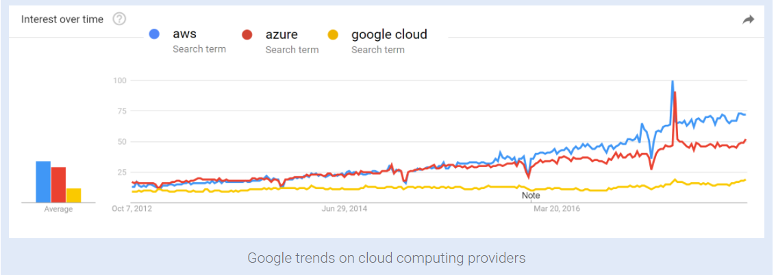
Cloud Environment Summary
Amazon Web Services (AWS)
Google Cloud
Established market
Reliable service
Cost benefits
Discounts
Innovation
Small company benefits
Microsoft Azure
Easy transition
PaaS strength

Slide 31
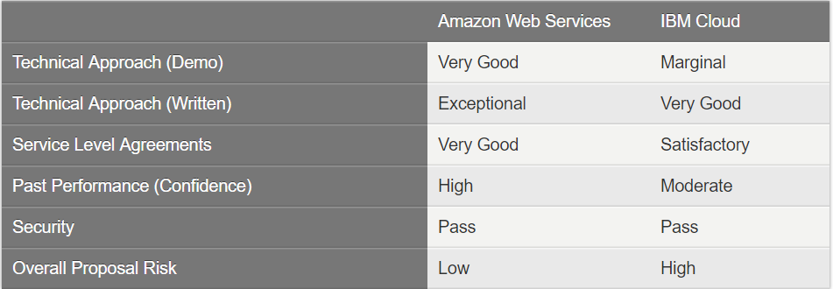
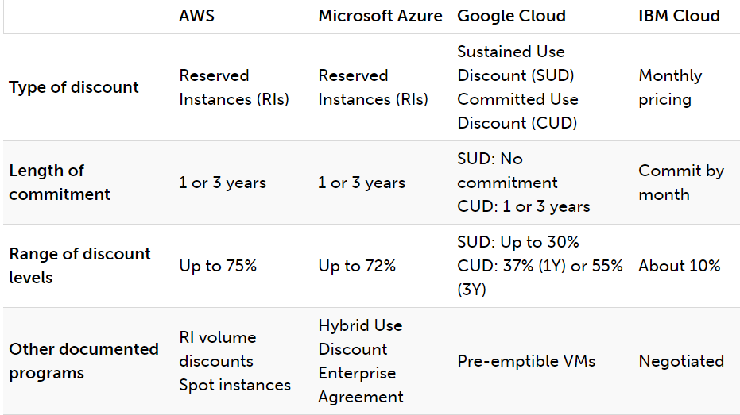
Alternative Cloud Environments - IBM
IBM SmartCloud
Customers: losing Facebook’s WhatsApp, American Airlines, Aviva, Carfax, Frito-Lay, IndiaFirst Life Insurance, 7-Eleven
Pros: high-value services (Watson), combining cognitive computing and cloud
Cons: little recognition as cloud leader, far smaller market than AWS and Azure, bouncing technology
Notes:
http://www.tomsitpro.com/articles/ibm-vs-aws-cia-private-cloud,2-663-2.html

Slide 32
Alternative Cloud Environments
Less Notable Alternatives
IBM Bluemix
Oracle Cloud Platform
Salesforce Sales App Cloud
Google App Engine
Notes:
Site articles on security breaches, issues with any alternatives

Slide 33
Recommendation
 | In-House | In Cloud ^{(AWS)}
Accessibility
Scalability
Downtime
Security
Economic Impact
Connectivity

Slide 34
Sources
Solution Analysis
https://sysgen.ca/cloud-vs-in-house-servers/
https://www.forbes.com/sites/forbestechcouncil/2017/07/25/the-cloud-vs-in-house-infrastructure-deciding-which-is-best-for-your-organization/#6582758e20f6
https://interface.ca/pros-and-cons-cloud-servers-vs-in-house-servers/
https://www.nibusinessinfo.co.uk/content/pros-and-cons-house-hosting
https://www.atlantech.net/blog/best-for-business-data-center-vs.-server-room
Cost Analysis
http://deepvalue.net/ec2-is-380-more-expensive-than-internal-cluster/
Cloud Environments
http://www.tomsitpro.com/articles/ibm-vs-aws-cia-private-cloud,2-663-2.html
https://services.google.com/fh/files/misc/google_cloud_and_the_gdpr_english.pdf
https://stackoverflow.blog/2017/07/21/trends-cloud-computing-uses-aws-uses-azure/
https://www.microsoft.com/en-us/TrustCenter/Privacy/gdpr/default.aspx
https://aws.amazon.com/compliance/eu-data-protection/

Slide 35
THANK
YOU
Notes:
Focus on (Market Analysis)
In House vs Cloud analysis
Environments:
focus on top two, add summary slide explaining top two, move additional analysis to backup
Nothing wrong with giving recommendations
from a scalability standpoint, cloud is winner
from a ___, ____ is winner
try for 5 factors down left side, check mark under cloud or in house as winner (my opinion)

